Slide 1


Albatel Project
Team 26, Project Code: MU-CS335-21-1PL,
Ryan Orimaco, Prabhnoor Kaur,
Laura Meyer, Eoin Yeates, Niamh Connolly

Slide 2


Introduction
Albatel require a fully functional HR Questionnaire for their customers.
Before starting the coding aspect of the project worked on ideas as a "brainstorming" approach to how to the system project should work.
Using the Waterfall Model approach, the group managed to gather ideas in a quick and reliable manner.
Brainstorming mixed with the Waterfall Model and the scrum method helped us create the Context and User Case Diagrams on short notice while also ensuring that everything was kept on time.
Context and Use Case Diagrams ensures that the company and the group understood in a clear and concise manner how the overall system will be implemented.

Slide 3
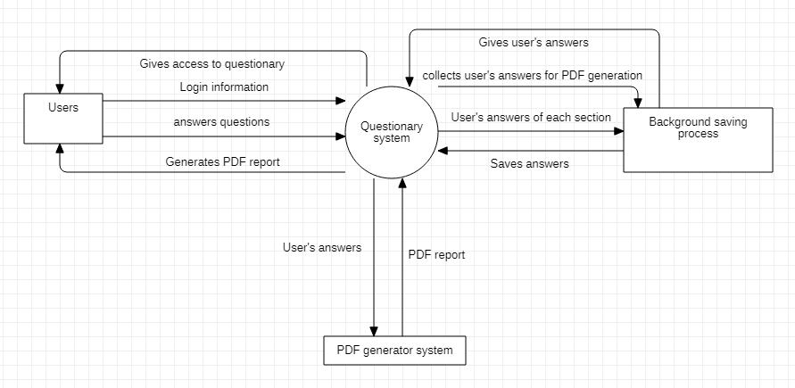
Context diagram
This is our context diagram, It demonstrates how users would interact with the System. The user gets access to the questionnaire system and after respondents answers questions, a pdf of results will be generated.

Slide 4
Implementation choices
The first idea was to implement it with Java, but it seems very complicated to do.
We decided to create this web questionnaire with HTML, CSS and JavaScript which seemed a lot easier to work with for this project.
For the charts we used to ChartJS to graph the answers the user selected and for the PDF we used to JSPDF
This project includes the basic parts of the login system, a sample of the questionnaire and the PDF generation at the end of the questionnaire which gives an analysis of the data given by the user.

Slide 5
Features in the code
Color theory:
We decided to use a green background for the questionnaire as this color represents, among other things, productivity, confidence and trust which are good feeling to complete a questionnaire about HR health in your company. We also used orange and blue as these three colors are triadic.
When answering a question, the user has three options:
Green which represents that everything is good in the company about the current subject.
Amber which means that things could be improved, or it needs some support.
Red which means that the company is not prepared for the situation.

Slide 6
Features in the code
Grouping of questions
Split up questions according to a topic is a good way to keep the user focus on one subject and so to give a sincere response.
Using a link
Having a link enables the IT service administrator to integrate the questionnaire easily in the current website structure.
Security
We provided a log in system to ensure the security of the questionnaire.
Convert to PDF
Converting to PDF after completion allows for the given answers to be easily digestible and charted when reviewing the questionnaire and accessible by all systems.

Slide 7
User Stories
User Story 1:
When the user logs in, they will be directed to a new page where they can choose between two options:-
1. Download the pdf report, 2. Share the pdf report by email. If the user chooses e-mail, then they will be asked to enter an email address. The user can access the report any time by login to the website.
Function: | Give the PDF report to the user.
Description: | Collect all the data given to the user to generate a report
Input: | Email address (optional)
Source: | Text area on the website completed by the user
Outputs: | PDF report
Destination: | User
Action: | Send report by email or start download
Requires: | User must choose a way to get the report
Precondition: | All previous questions must have been answered
Postcondition: | PDF report must be generated
Side-effects: | None
Acceptance Criteria:
The user must choose an option to access the pdf report

Slide 8
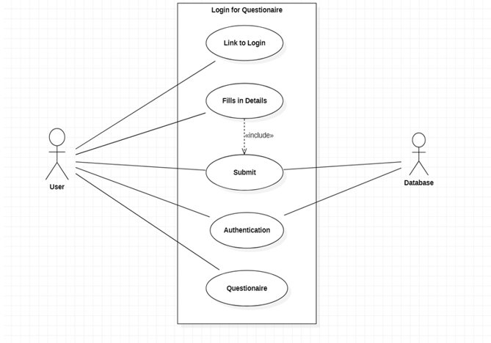
Use case diagram
In this case diagram our user plans on logging in to the questionnaire. We can see they are able to login, complete the questionnaire, submit to the online HR database and authenticate after completion. The act of accessing the questionnaire is very streamlined and provides the user a quick access and completion.

Slide 9
User Stories
User Story 2:
Each question requires an answer as it is a questionnaire. As a user who is currently doing questionnaire, A user will require to answer the question using radio buttons. I will need 3 options to choose from depending on the confidence level I have about each question, ranging from red (least confident) to green (most confident).
Acceptance Criteria:
I must choose one of the three options.
I cannot choose more than one option.
Function | Clicks on the users chosen option
Description | When the user clicks one of the 3 options, the user will know that they have chosen the correct radio button when it clicked
Source: | 3 radio buttons red, amber, and green.
Outputs: | Radio Buttons
Destination: | Another circle telling the user that they have chosen the option of their choice
Action: | That section of the questionnaire
Requires: | Clicking of radio buttons
Precondition | Clicking of radio buttons
Postcondition: | Users must think what option they would like to choose before choosing the appropriate option
Side-effects: | None

Slide 10
Live Demonstration

Slide 11
Thank You
Ryan Orimaco
Niamh Connolly
Prabhnoor Kaur
Eoin Yeates
Laura Meyer

